Slide 1


R. GLENN
HUBBARD
ANTHONY PATRICK
O’BRIEN
FIFTH EDITION
© 2015 Pearson Education, Inc.

Slide 2
Technology, Production, and Costs

Slide 3
Technology: An Economic Definition
11.1
Define technology and give examples of technological change.

Slide 4
Firms and technologies
The basic activity of a firm is to use inputs, for example
Workers,
Machines, and
Natural resources
to produce outputs of goods and services.
We call the process by which a firm does this a technology; if a firm improves its ability to turn inputs into outputs, we refer to this as a positive technological change.
Technology: The processes a firm uses to turn inputs into outputs of goods and services.
Technological change: A change in the ability of a firm to produce a given level of output with a given quantity of inputs.

Slide 5

Inventory control at Wal-Mart
One of Wal-Mart’s important inputs is its inventory. Wal-Mart invests money to improve management of its inventory, by linking the cash registers with inventory-control computers.
Improvements in this technology help Wal-Mart to be more efficient turning its inputs (inventory, labor, physical store, etc.) into its outputs (sales of products).

Slide 6
The Short Run and the Long Run in Economics
11.2
Distinguish between the economic short run and the economic long run.

Slide 7
The short and the long run in economics
Economists refer to the short run as a period of time during which at least one of a firm’s inputs is fixed.
Example: A firm might have a long-term lease on a factory that is too costly to get out of.
In the long run, no inputs are fixed, the firm can adopt new technology, and increase or decrease the size of its physical plant.

Slide 8
Fixed and variable costs
The division of time into the short and long run reveals two types of costs:
Variable costs are costs that change as output changes, while
Fixed costs are costs that remain constant as output changes.
In the long run, all of a firm’s costs are variable, since the long run is a sufficiently long time to alter the level of any input.
Since all costs are by definition either fixed or variable, we can say the following:
Total cost = Fixed cost +Variable cost
or, in symbols:
TC = FC + VC

Slide 9
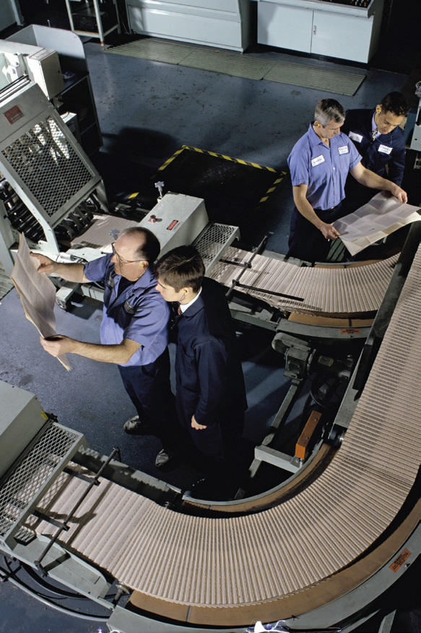
Costs in the publishing industry
An academic book publisher turns its inputs (intellectual property, labor, printing machines, paper, factory, electricity, etc.) into its outputs (books).
As it increases the number of books it publishes, some of those inputs stay constant and some rise. Can you identify which ones?

Slide 10
Explicit and implicit costs
Recall that economists like to consider all of the opportunity costs of an activity; both the explicit costs and the implicit costs.
Explicit cost: A cost that involves spending money
Implicit cost: A non-monetary opportunity cost
The explicit costs of running a firm are relatively easy to identify: just look at what the firm spends money on.
The implicit costs are a little harder; finding them involves identify the resources used in the firm that could have been used for another beneficial purpose.
Example: If you own your own firm, you probably spend time working on the firm’s activities. Even if you don’t “pay yourself” explicitly for that time, it is still an opportunity cost.

Slide 11
Opening a pizza store
For example, suppose Jill Johnson quits her $30,000 a year job to start a pizza store. She uses $50,000 of her savings to buy equipment—furniture, etc.—and takes out a loan as well.
The items in red are explicit costs.
The items in blue are implicit costs: her foregone salary, the interest the money could have earned…
Pizza dough, tomato sauce, and other ingredients | $20,000
Wages | 48,000
Interest payments on loan to buy pizza ovens | 10,000
Electricity | 6,000
Lease payment for store | 24,000
Foregone salary | 30,000
Foregone interest | 3,000
Economic depreciation | 10,000
Total | $151,000
Table 11.1
Jill Johnson’s costs per year

Slide 12
Opening a pizza store—continued
… and economic depreciation (decrease in resale value) on the capital items Jill bought.
All of these implicit costs are real costs of Jill owning the pizza store, even if they don’t require an explicit outlay of money.
Notice in particular Jill “charging herself” for the money she took out of her savings, just like the bank charges for her loans.
Pizza dough, tomato sauce, and other ingredients | $20,000
Wages | 48,000
Interest payments on loan to buy pizza ovens | 10,000
Electricity | 6,000
Lease payment for store | 24,000
Foregone salary | 30,000
Foregone interest | 3,000
Economic depreciation | 10,000
Total | $151,000
Table 11.1
Jill Johnson’s costs per year

Slide 13
Production at Jill Johnson’s restaurant
Jill Johnson’s restaurant turns its inputs (pizza ovens, ingredients, labor, electricity, etc.) into pizzas for sale.
To make analysis simple, let’s consider only two inputs:
The pizza ovens, and
Workers
The pizza ovens will be a fixed cost; we will assume Jill cannot change (in the short run) the number of ovens she has.
The workers will be a variable cost; we will assume Jill can easily change the number of workers she hires.

Slide 14
Jill Johnson’s production function
Jill Johnson’s restaurant has a particular technology by which it transforms workers and pizza ovens into pizzas.
As the number of workers increases, so does that number of pizzas able to be produced.
This is the firm’s production function: the relationship between the inputs employed and the maximum output of the firm.
Quantity of Workers | Quantity of Pizza Ovens | Quantity of Pizzas per Week
0 | 2 | 0
1 | 2 | 200
2 | 2 | 450
3 | 2 | 550
4 | 2 | 600
5 | 2 | 625
6 | 2 | 640
Table 11.2
Short-run production and cost at Jill Johnson’s restaurant

Slide 15
Jill Johnson’s costs
Each pizza oven costs $400 per week, and each worker costs $650 per week.
So the firm has $800 in fixed costs, and its costs go up $650 for each worker employed.
Quantity of Workers | Quantity of Pizza Ovens | Quantity of Pizzas per Week | Cost of Pizza Ovens (Fixed Cost) | Cost of Workers (Variable Cost) | Total Cost of Pizzas per Week
0 | 2 | 0 | $800 | $0 | $800
1 | 2 | 200 | 800 | 650 | 1,450
2 | 2 | 450 | 800 | 1,300 | 2,100
3 | 2 | 550 | 800 | 1,950 | 2,750
4 | 2 | 600 | 800 | 2,600 | 3,400
5 | 2 | 625 | 800 | 3,250 | 4,050
6 | 2 | 640 | 800 | 3,900 | 4,700
Table 11.2
Short-run production and cost at Jill Johnson’s restaurant

Slide 16
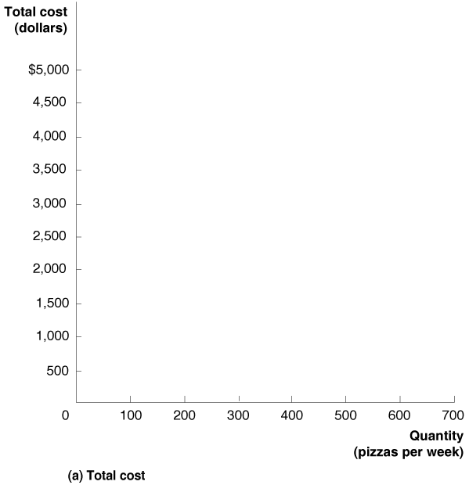
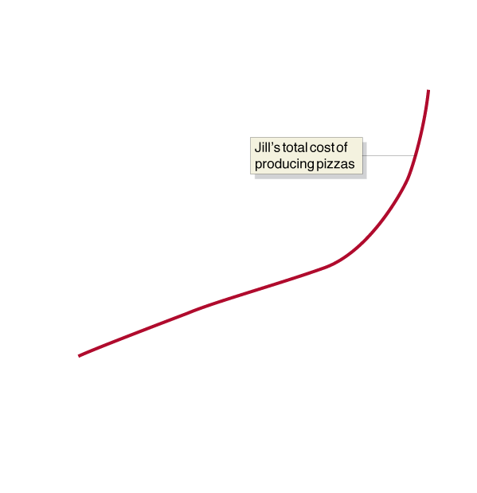

A graph of the restaurant’s cost
Using the information from the table, we can graph the costs for Jill Johnson’s restaurant.
Notice that cost is not zero when quantity is zero, because of the fixed cost of the pizza ovens.
Naturally, costs increase as Jill wants to make more pizzas.
Figure 11.1a
Graphing total cost and average total cost at Jill Johnson’s restaurant
Notes:
We can use the information from Table 11.2 to graph the relationship between
the quantity of pizzas Jill produces and her total cost and average total cost.
Panel (a) shows that total cost increases as the level of production increases.
Panel (b) shows that her average total cost is roughly U shaped: As production
increases from low levels, average total cost falls, before rising at higher levels
of production.

Slide 17
Jill Johnson’s average total cost per pizza
If we divide the total cost of the pizzas by the number of pizzas, we get the average total cost of the pizzas.
For low levels of production, the average cost falls as the number of pizzas rises; at higher levels, the average cost rises as the number of pizzas rises.
Quantity of Workers | Quantity of Pizza Ovens | Quantity of Pizzas per Week | Cost of Pizza Ovens (Fixed Cost) | Cost of Workers (Variable Cost) | Total Cost of Pizzas per Week | Cost per Pizza (Average Total Cost)
0 | 2 | 0 | $800 | $0 | $800 | —
1 | 2 | 200 | 800 | 650 | 1,450 | $7.25
2 | 2 | 450 | 800 | 1,300 | 2,100 | 4.67
3 | 2 | 550 | 800 | 1,950 | 2,750 | 5.00
4 | 2 | 600 | 800 | 2,600 | 3,400 | 5.67
5 | 2 | 625 | 800 | 3,250 | 4,050 | 6.48
6 | 2 | 640 | 800 | 3,900 | 4,700 | 7.34
Table 11.2
Short-run production and cost at Jill Johnson’s restaurant

Slide 18


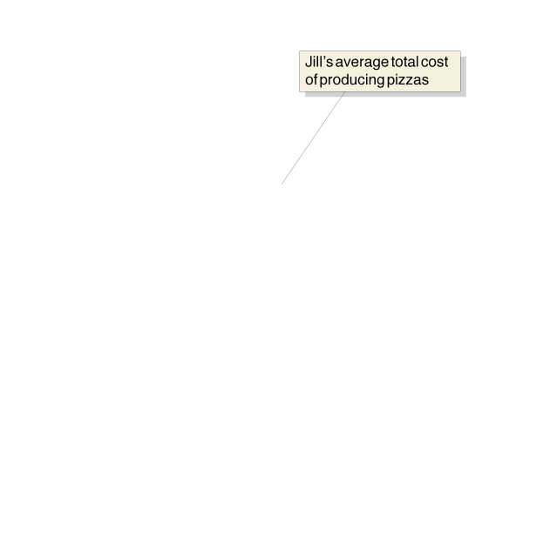
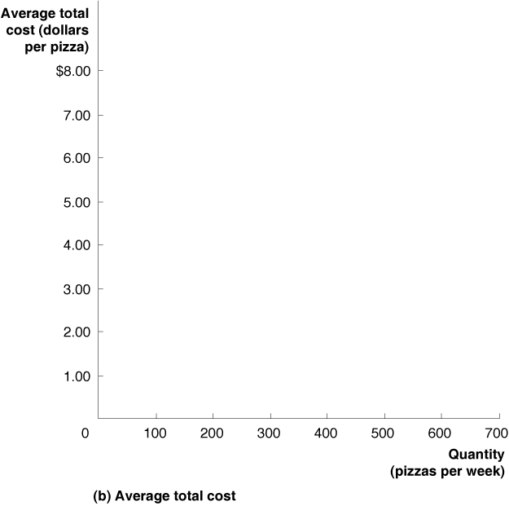
The restaurant’s average total cost curve
The “falling-then-rising” nature of average total costs results in a U-shaped average total cost curve.
Our next task is to examine why we get this shape for average total costs.
Figure 11.1b
Graphing total cost and average total cost at Jill Johnson’s restaurant

Slide 19
The Marginal Product of Labor and the Average Product of Labor
11.3
Understand the relationship between the marginal product of labor and the average product of labor.

Slide 20
Worker output at the pizza restaurant
Suppose Jill Johnson hires just one worker; what does that worker have to do?
Take orders
Make and cook the pizzas
Take pizzas to the tables
Run the cash register, etc.
By hiring another worker, these tasks could be divided up, allowing for some specialization to take place, resulting from the division of labor.
Two workers can probably produce more output per worker than one worker can alone.

Slide 21
Marginal product of labor
Let’s look more closely at what happens as Jill Johnson hires more workers.
To think about this, let’s consider the marginal product of labor: the additional output a firm produces as a result of hiring one more worker.
The first worker increases output by 200 pizzas; the second increases output by 250.
Quantity of Workers | Quantity of Pizza Ovens | Quantity of Pizzas
0 | 2 | 0
1 | 2 | 200
2 | 2 | 450
3 | 2 | 550
4 | 2 | 600
5 | 2 | 625
6 | 2 | 640
Table 11.3
The marginal product of labor at Jill Johnson’s restaurant

Slide 22
The law of diminishing returns
Additional workers add to the potential output, but not by as much. Eventually they start getting in each other’s way, etc., because there is only a fixed number of pizza ovens, cash registers, etc.
This is the Law of Diminishing Returns: at some point, adding more of a variable input to the same amount of a fixed input will cause the marginal product of the variable input to decline.
Quantity of Workers | Quantity of Pizza Ovens | Quantity of Pizzas | Marginal Product of Labor
0 | 2 | 0 | —
1 | 2 | 200 | 200
2 | 2 | 450 | 250
3 | 2 | 550 | 100
4 | 2 | 600 | 50
5 | 2 | 625 | 25
6 | 2 | 640 | 15
Table 11.3
The marginal product of labor at Jill Johnson’s restaurant

Slide 23
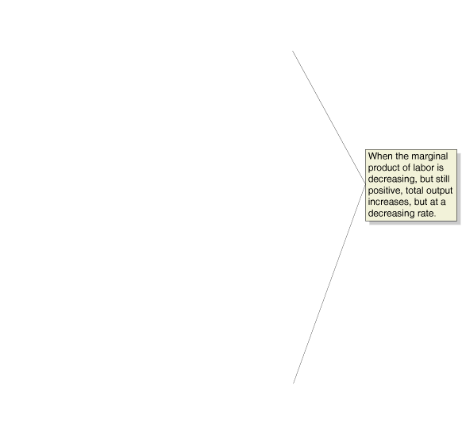
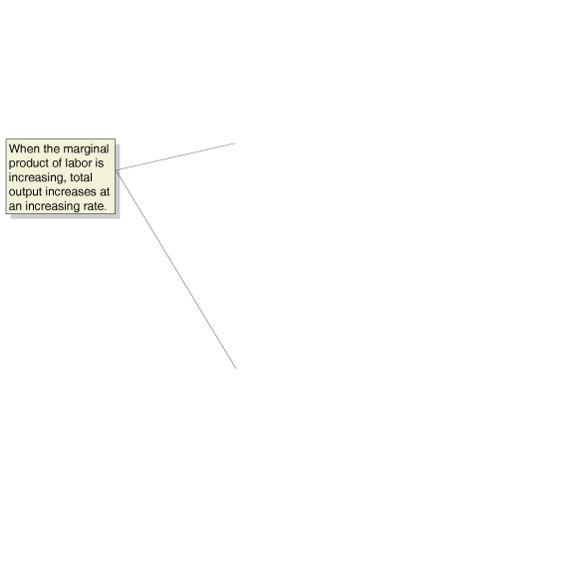





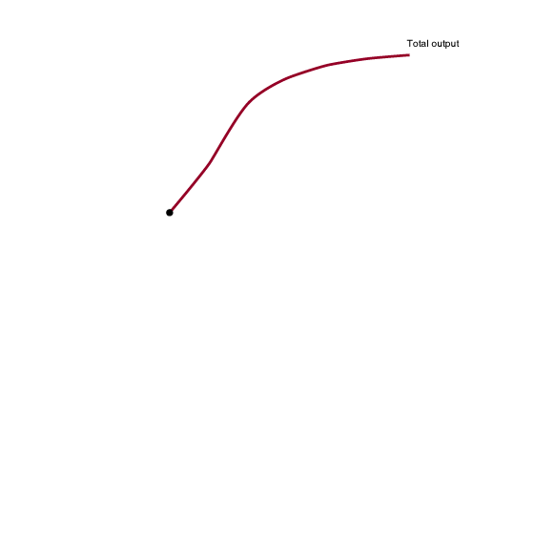
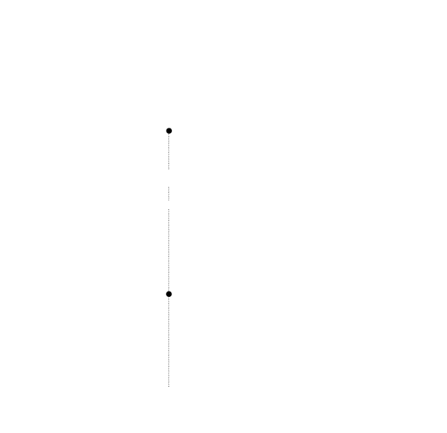
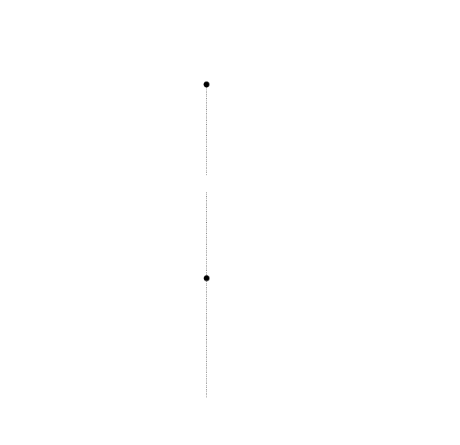

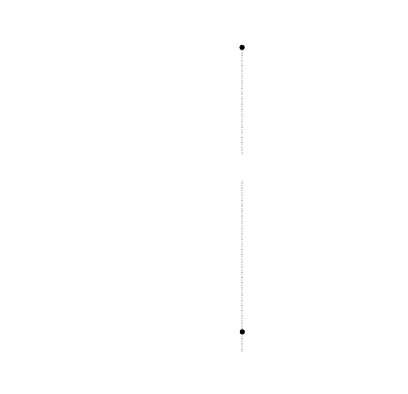

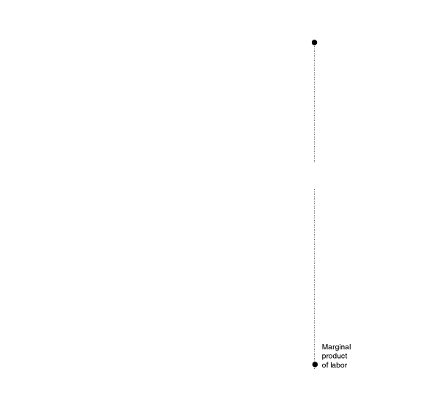
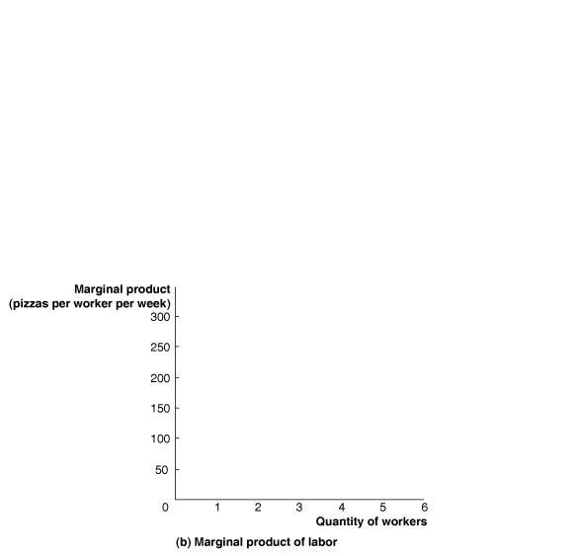
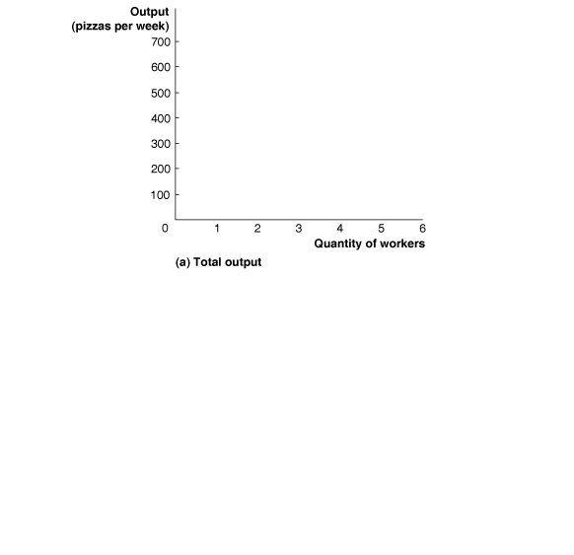
Graphs of output and marginal product of labor
Graphing the output and marginal product against the number of workers allows us to see the law of diminishing returns more clearly.
The output curve flattening out, and the decreasing marginal product curve, both illustrate the law of diminishing returns.
Figure 11.2
Total output and the marginal product of labor
Notes:
In panel (a), output increases as more workers are hired, but the increase in
output does not occur at a constant rate. Because of specialization and the division
of labor, output at first increases at an increasing rate, with each additional
worker hired causing production to increase by a greater amount than
did the hiring of the previous worker. When the point of diminishing returns
is reached, production increases at a decreasing rate. Each additional worker
Jill hires after the second worker causes production to increase by a smaller
amount than did the hiring of the previous worker. In panel (b), the marginal
product of labor is the additional output produced as a result of hiring one
more worker. The marginal product of labor rises initially because of the effects
of specialization and division of labor, and then falls because of the effects
of diminishing returns.

Slide 24
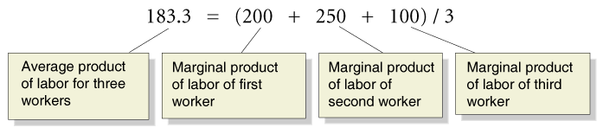
Average product of labor
Another useful indication of output is the average product of labor, calculated as the total output produced by a firm divided by the quantity of workers.
With 3 workers, the restaurant can produce 550 pizzas, giving an average product of labor of
550 / 3 = 183.3
A useful way to think about this is that the average product of labor is the average of the marginal products of labor.
The first three workers give 200, 250, and 100 additional pizzas respectively:

Slide 25
Average and marginal product of labor
With only two workers, the average product of labor was
450 / 2 = 225
So the third worker made the average product of labor go down.
This happened because the third worker produced less (marginal) output than the average of the previous workers.
If the next worker produces more (marginal) output than the average, then the average product will rise instead.
The next slide illustrates this idea using college grade point averages (GPAs).

Slide 26
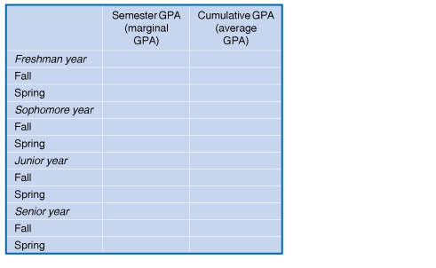


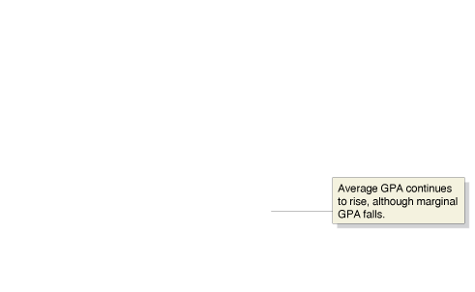

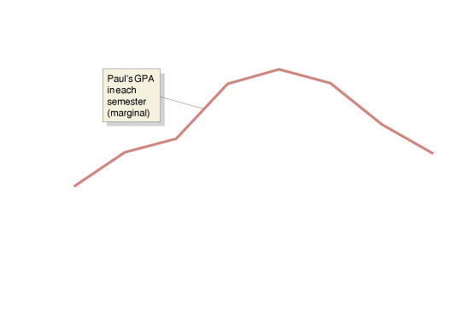
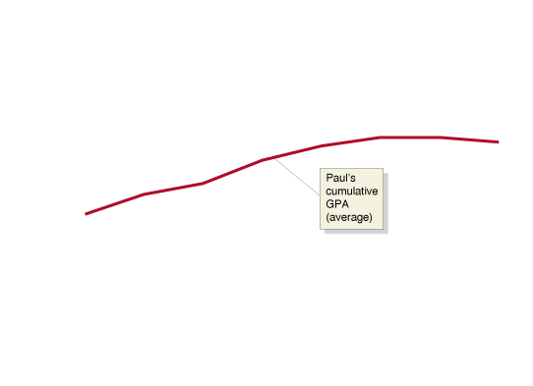


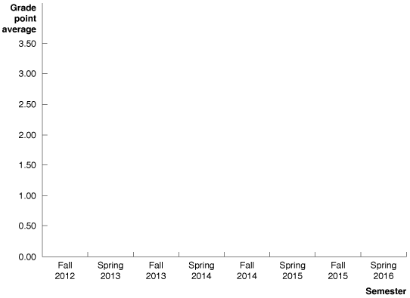
College GPAs as a metaphor for production
Paul’s semester GPA starts off poorly, rises, then eventually falls in his senior year.
His cumulative GPA follows his semester GPA upward, as long as the semester GPA is higher than the cumulative GPA.
When his semester GPA dips down below the cumulative GPA, the cumulative GPA starts to head down also.
Figure 11.3
Marginal and average GPAs
Notes:
The relationship between marginal and average
values for a variable can be illustrated
using GPAs. We can calculate the GPA Paul
earns in a particular semester (his “marginal
GPA”), and we can calculate his cumulative
GPA for all the semesters he has completed
so far (his “average GPA”). Paul’s GPA is only
1.50 in the fall semester of his first year. In
each following semester through the fall of
his junior year, his GPA for the semester
increases—raising his cumulative GPA. In
Paul’s junior year, even though his semester
GPA declines from fall to spring, his cumulative
GPA rises. Only in the fall of his senior
year, when his semester GPA drops below
his cumulative GPA, does his cumulative
GPA decline.

Slide 27
The Relationship between Short-Run Production and Short-Run Cost
11.4
Explain and illustrate the relationship between marginal cost and average total cost.

Slide 28
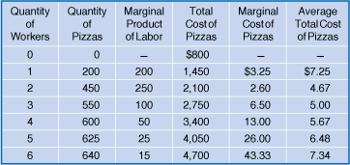
Average and marginal costs of production
We have already seen the average total cost: total cost divided by output.
We can also define the marginal cost as the change in a firm’s total cost from producing one more unit of a good or service; in symbols,
The ΔQ is generally needed, because we don’t see quantity increasing by only one unit at a time.

Slide 29
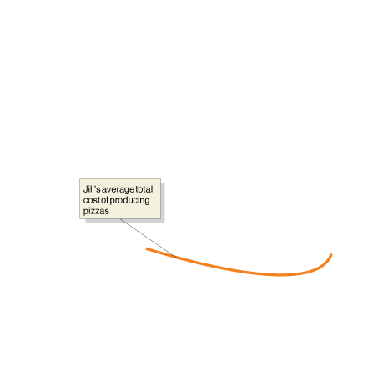
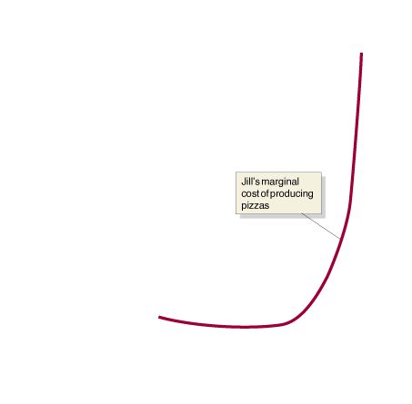
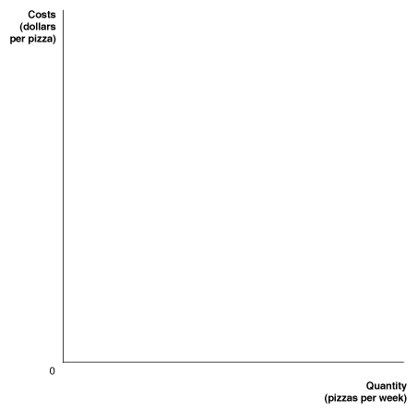
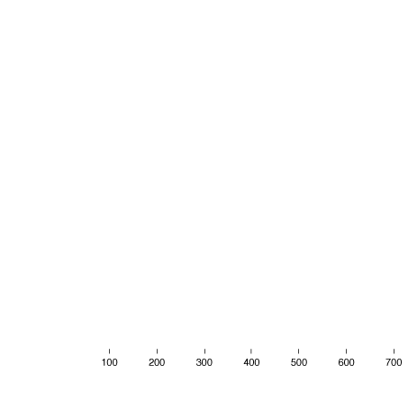



Graphing average and marginal costs
We can visualize the average and marginal costs of production with a graph.
The first two workers increase average production, and cause cost per unit to fall; the next four workers are less productive, resulting in high marginal costs of production.
Since the average cost of production “follows” the marginal cost down and then up, this generates a U-shaped average cost curve.
Figure 11.4
Jill Johnson’s marginal cost and average total cost of producing pizzas
Notes:
We can use the information in the table to
calculate Jill’s marginal cost and average
total cost of producing pizzas. For the first
two workers hired, the marginal product of
labor is increasing, which causes the marginal
cost of production to fall. For the last
four workers hired, the marginal product
of labor is falling, which causes the marginal
cost of production to increase. Therefore,
the marginal cost curve falls and then
rises—that is, has a U shape—because the
marginal product of labor rises and then
falls. As long as marginal cost is below average
total cost, average total cost will be falling.
When marginal cost is above average
total cost, average total cost will be rising.
The relationship between marginal cost and
average total cost explains why the average
total cost curve also has a U shape.

Slide 30
Graphing Cost Curves
11.5
Graph average total cost, average variable cost, average fixed cost, and marginal cost.

Slide 31
Decomposing the total and average costs
We know that total costs can be divided up into fixed and variable costs:
TC = FC + VC
If we divide both sides by the level of output (Q), we obtain a useful relationship:
TC / Q = FC / Q + VC / Q
The first quantity is average total cost.
The second is average fixed cost: fixed cost divided by the quantity of output produced.
The third is average variable cost: variable cost divided by the quantity of output produced.
So ATC = AFC + AVC

Slide 32
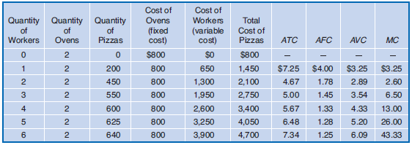
Observations about costs
Observe that:
In each row, ATC = AFC + AVC.
When MC is above ATC, ATC is falling.
When MC is above ATC, ATC is rising.
The same is true for MC and AVC.
Figure 11.5a
Costs at Jill Johnson’s restaurant
Notes:
Jill’s costs of making pizzas are shown in
the table and plotted in the graph. Notice
three important facts about the graph:
(1) The marginal cost (MC), average total
cost (ATC), and average variable cost (AVC)
curves are all U shaped, and the marginal
cost curve intersects both the average variable
cost curve and the average total cost
curve at their minimum points. (2) As output
increases, average fixed cost (AFC) gets
smaller and smaller. (3) As output increases,
the difference between average total cost
and average variable cost decreases. Make
sure you can explain why each of these
three facts is true. You should spend time
becoming familiar with this graph because
it is one of the most important graphs in
microeconomics.

Slide 33
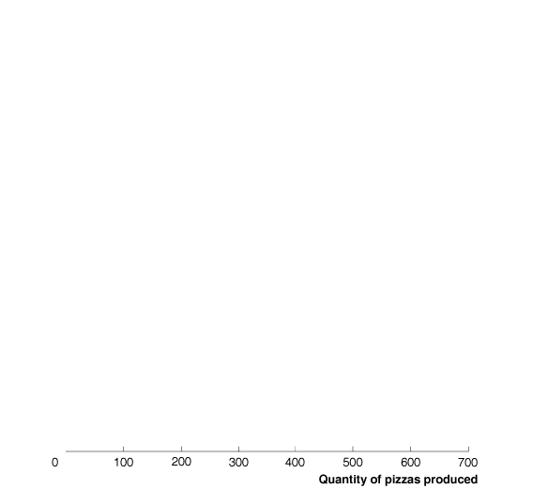
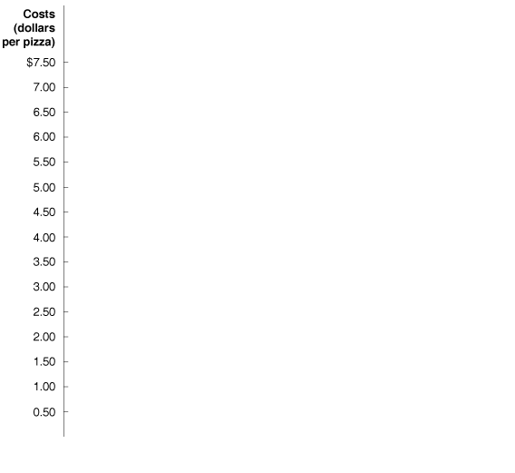
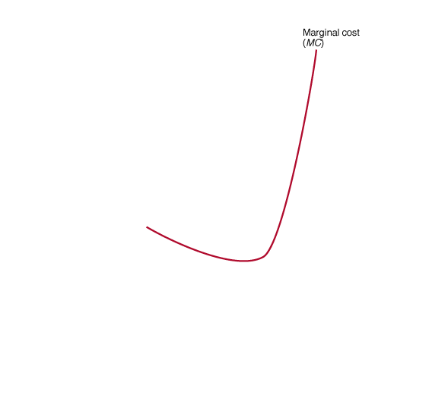
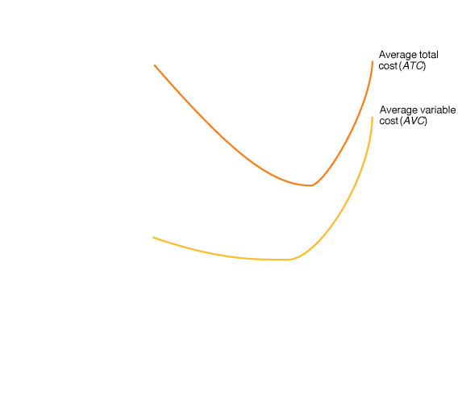
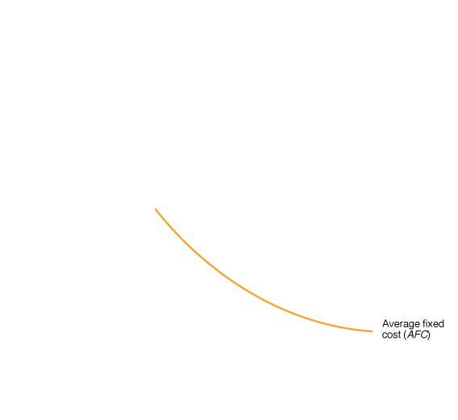


Graphing the various cost curves
This results in both
ATC and AVC having their U-shaped curves.
The MC curve cuts through each at its minimum point, since both ATC and AVC “follow” the MC curve.
Also notice that the vertical sum of the AVC and AFC curves is the ATC curve.
And because AFC gets smaller, the ATC and AVC curves converge.
Figure 11.5b
Costs at Jill Johnson’s restaurant

Slide 34
Costs in the Long Run
11.6
Understand how firms use the long-run average cost curve in their planning.

Slide 35
The long run and average costs
Recall that the long run is a sufficiently long period of time that all costs are variable.
So In the long run, there is no distinction between fixed and variable costs.
A long-run average cost curve shows the lowest cost at which a firm is able to produce a given quantity of output in the long run, when no inputs are fixed.

Slide 36
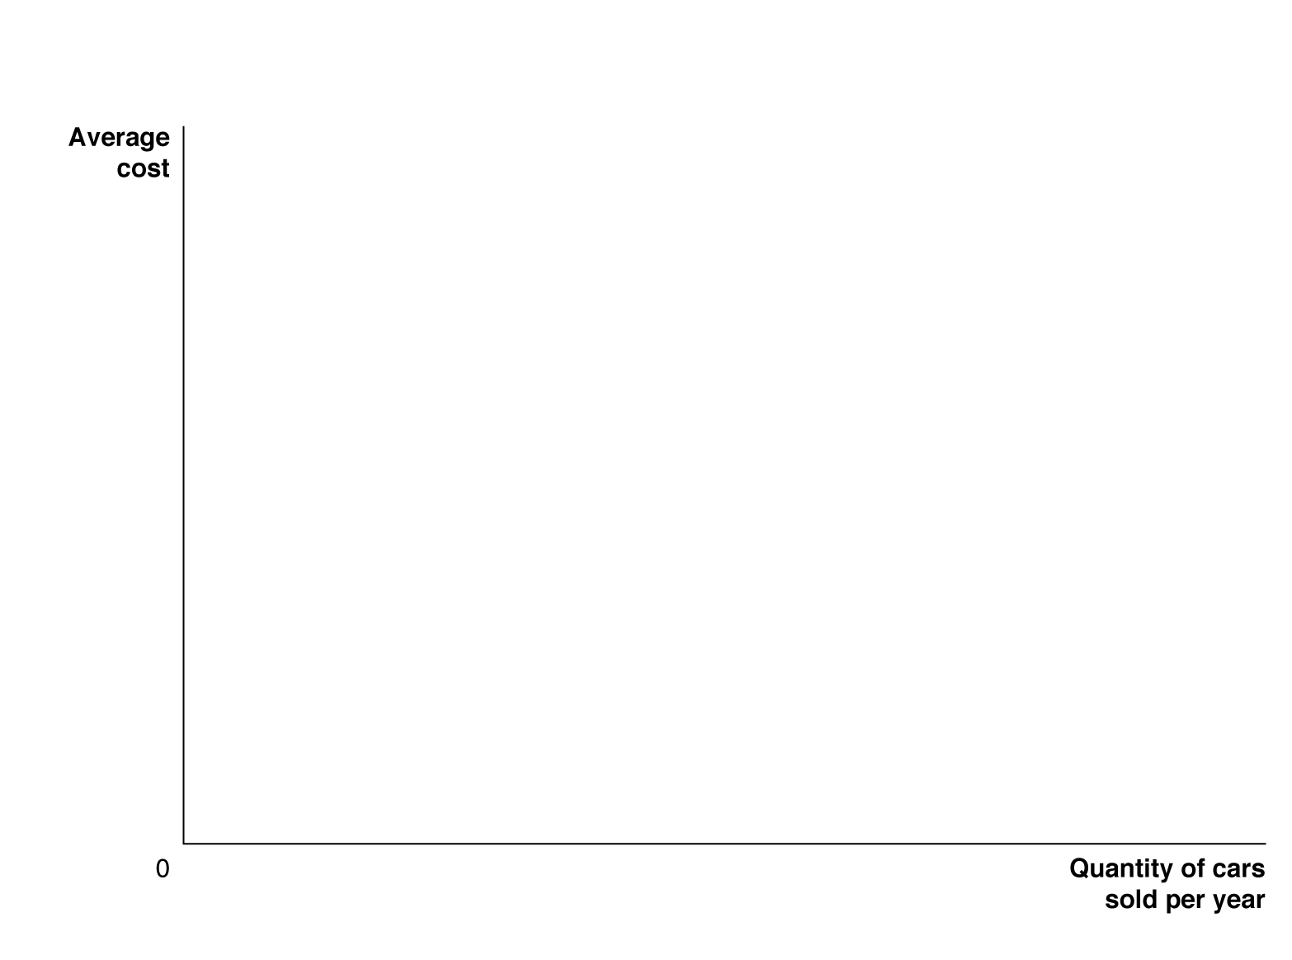
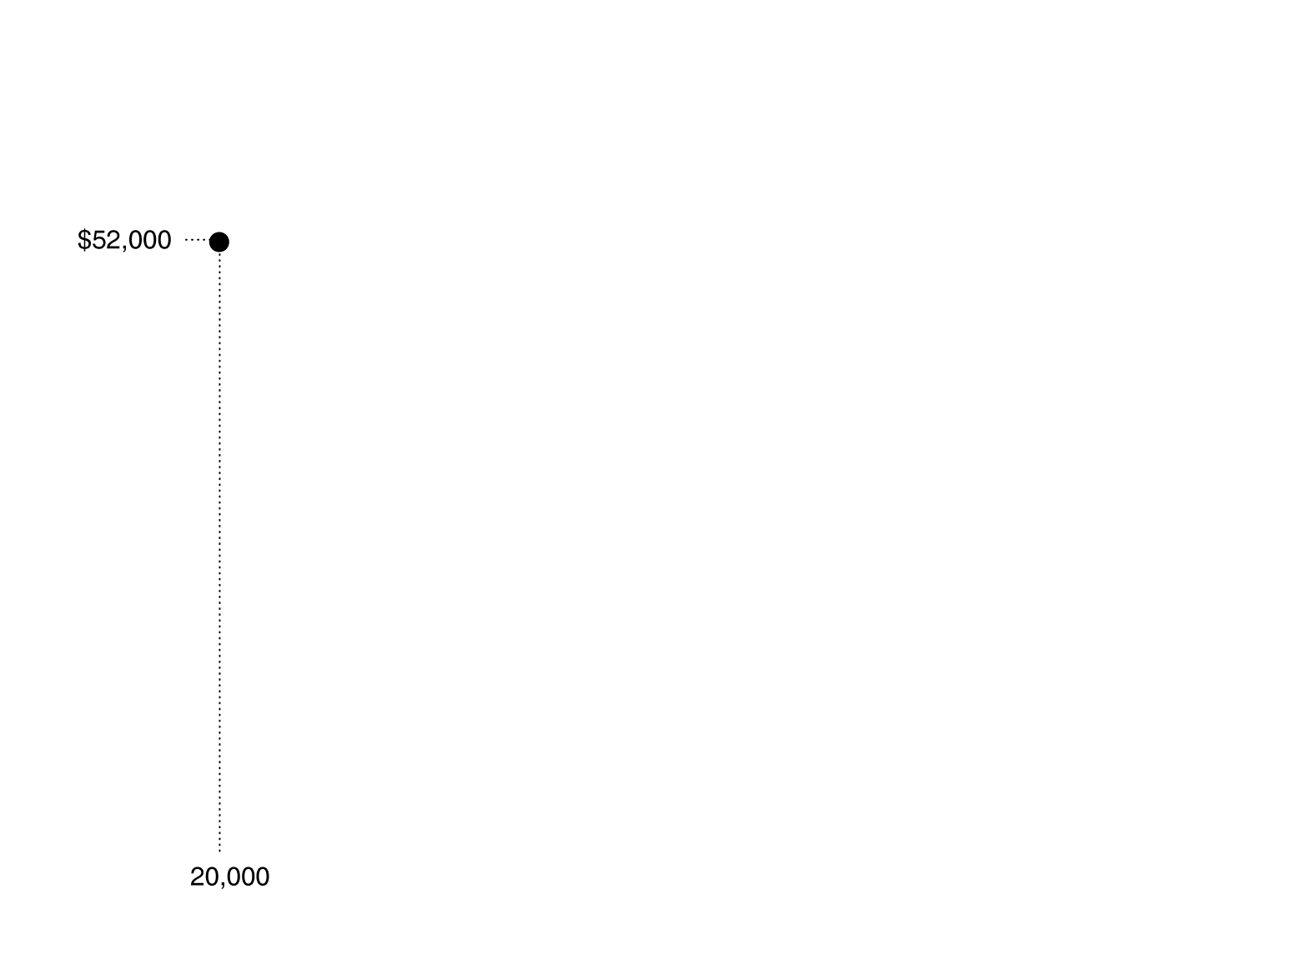


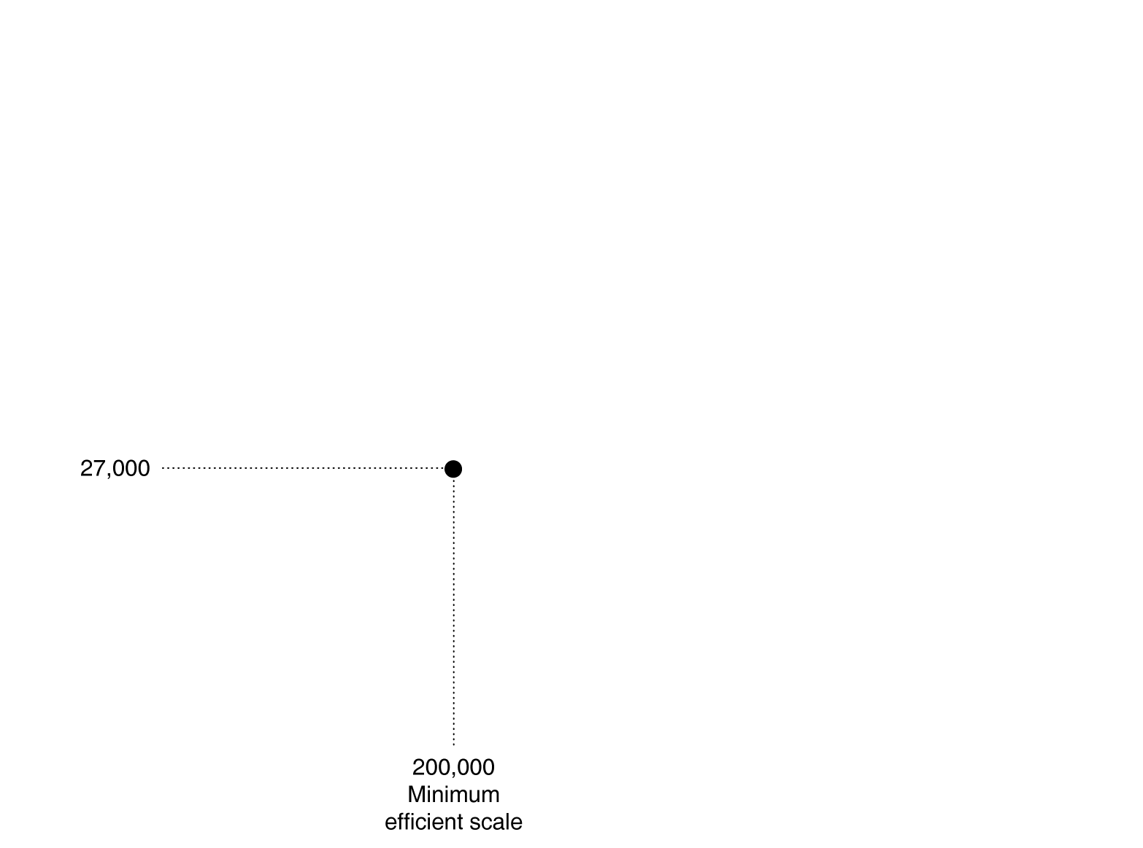


Economies of scale
As output changes, the long run average cost might change also.
At low quantities, a firm might experience economies of scale: the firm’s long-run average costs falling as it increases the quantity of output it produces.
Here, a small car factory can produce at a lower average cost than a large one, for small quantities. For more output, a larger factory is more efficient.
Figure 11.6
The relationship between short-run average cost and long-run average cost
Notes:
If a small car company expects to sell only
20,000 cars per year, it will be able to produce
cars at the lowest average cost of $52,000 per
car if it builds the small factory represented
by the ATC curve on the left of the figure.
A larger factory will be able to produce 200,000
cars per year at a lower cost of $27,000 per car.
An automobile factory producing 200,000
cars per year and a factory producing 400,000
cars per year will experience constant returns
to scale and have the same average cost. An
automobile factory assembling 200,000 cars
per year will have reached minimum efficient
scale. Very large automobile factories will experience
diseconomies of scale, and their average
costs will rise as production increases
beyond 400,000 cars per year.

Slide 37
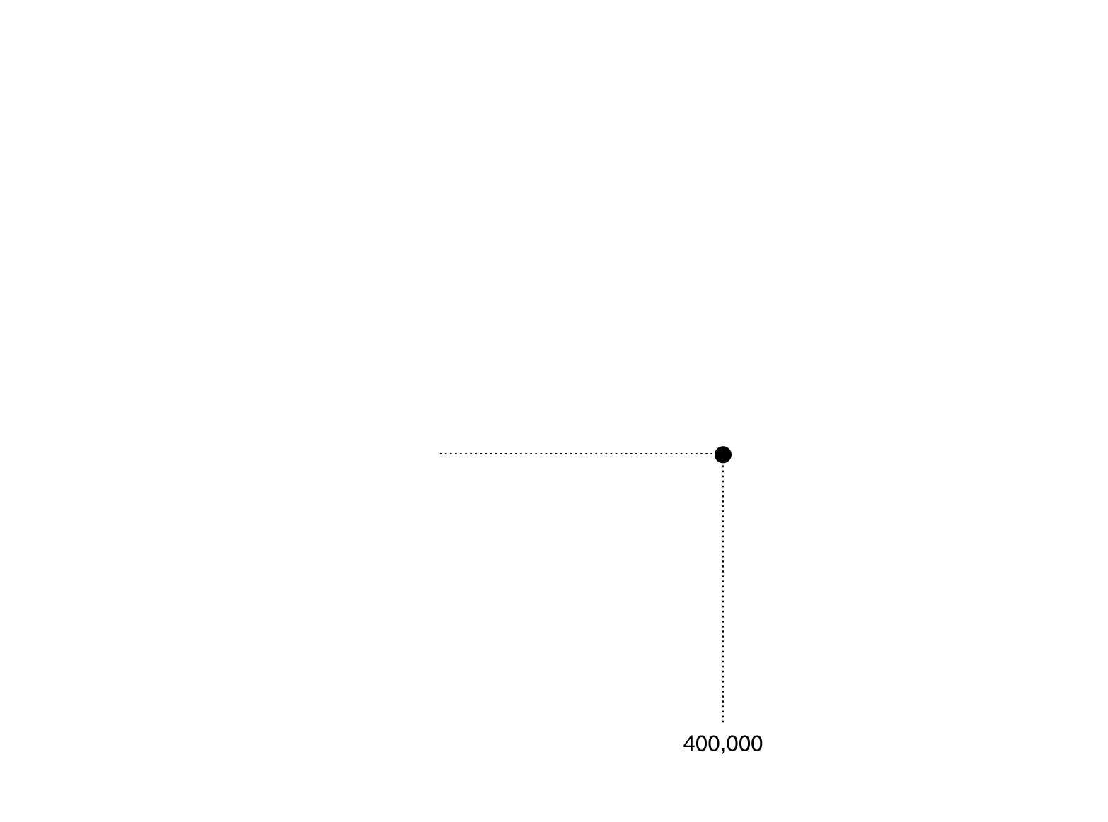

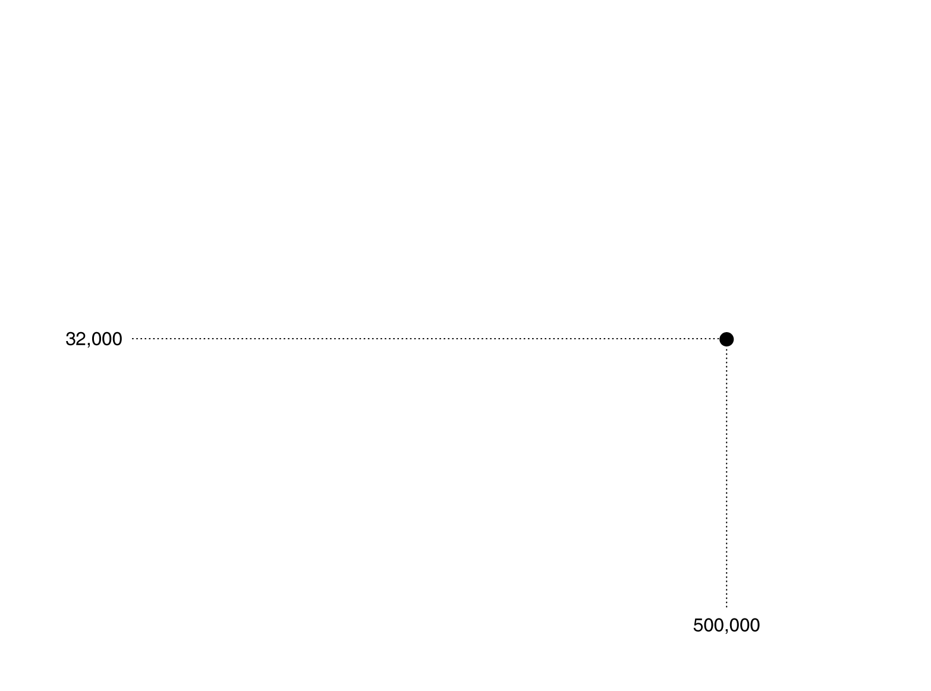

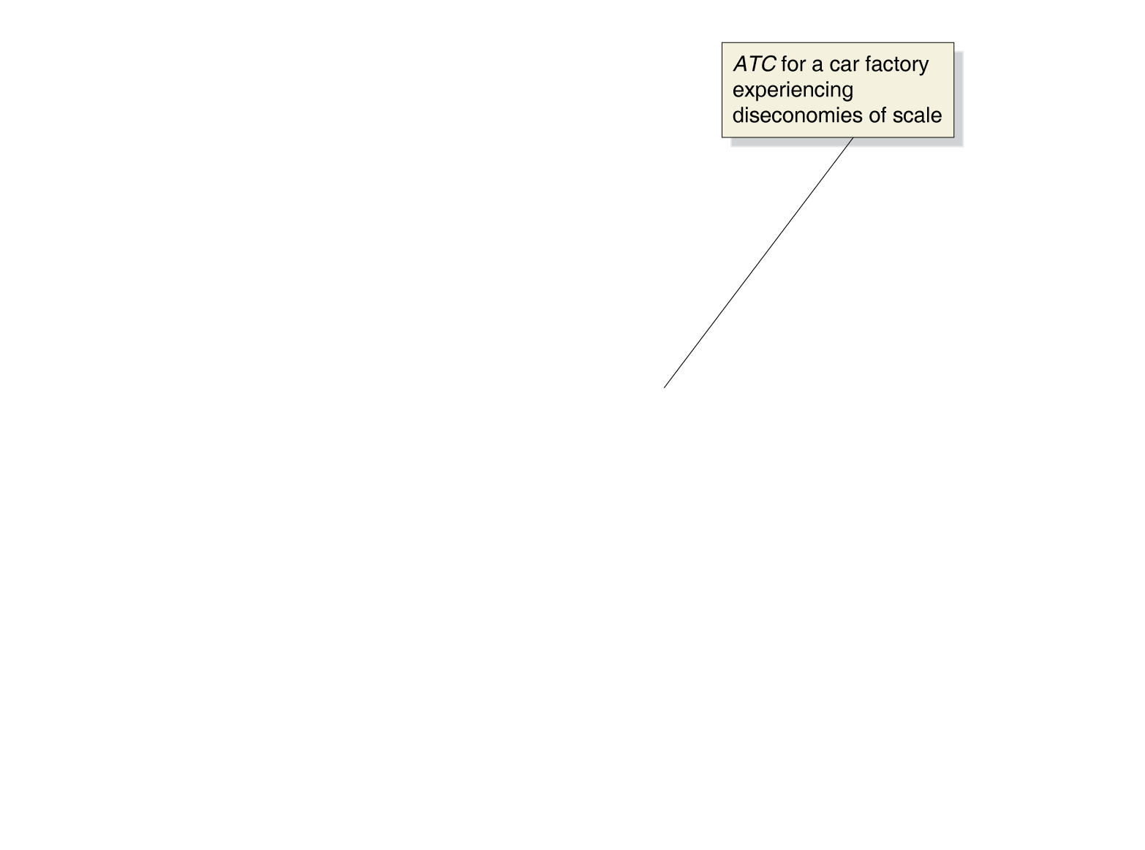
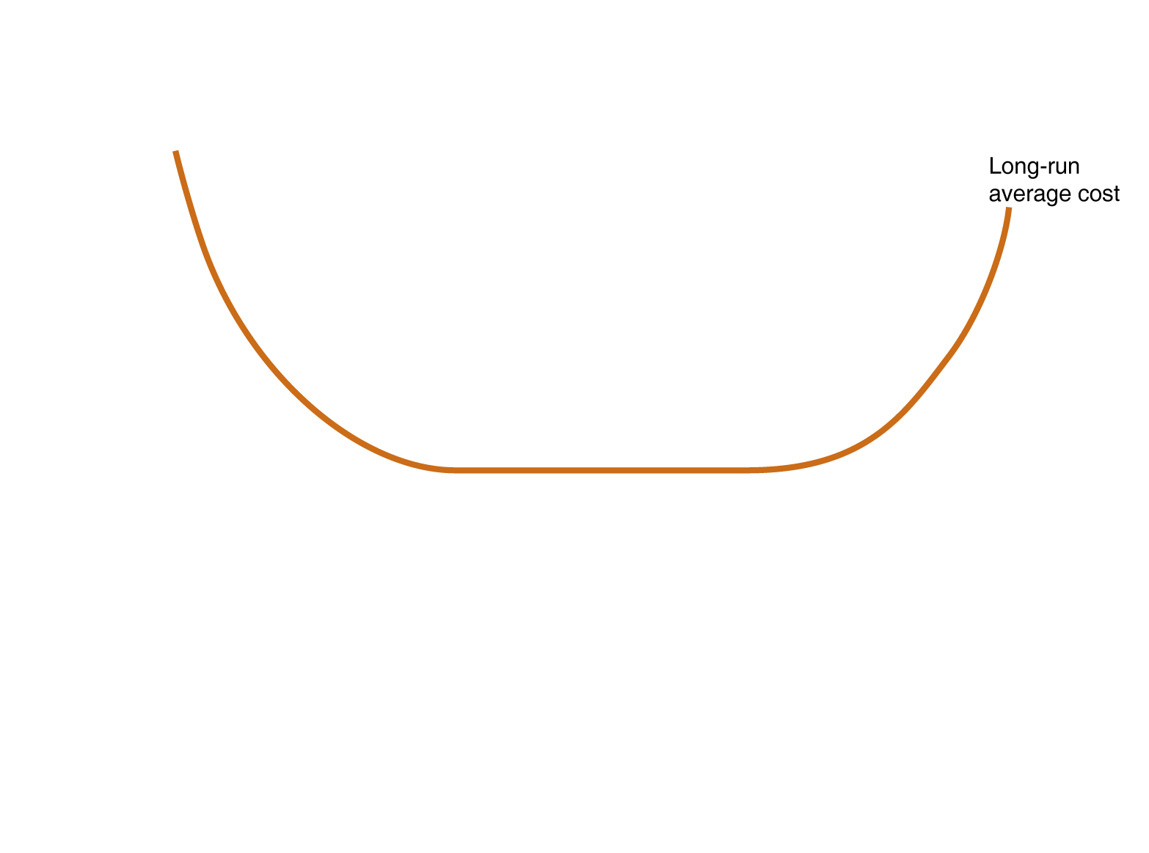
Constant returns to scale
The lowest level of output at which all economies of scale are exhausted is known as the minimum efficient scale.
At some point, growing larger does not allow more economies of scale. The firm experiences constant returns to scale: its long-run average cost remains unchanged as it increases output.
Figure 11.6
The relationship between short-run average cost and long-run average cost

Slide 38
Diseconomies of scale
Eventually, firms might get so large that they experience diseconomies of scale: a situation in which a firm’s long-run average costs rise as the firm increases output.
This might happen because the firm gets to large to manage effectively, or because the firm has to employ workers or other factors of production that are less well suited to production.
Figure 11.6
The relationship between short-run average cost and long-run average cost

Slide 39
Long-run average costs curves for automobile factories
Why might a car company experience economies of scale?
Production might increase at a greater-than-proportional rate as inputs increase.
Having more workers can allow specialization.
Large firms may be able to purchase inputs at lower prices.
But economies of scale will not last forever.
Eventually managers may have difficulty coordinating huge operations.
“Demand for… high volumes saps your energy. Over a period of time, it eroded our focus… [and] thinned out the expertise and knowledge we painstakingly built up over the years.”
- President of Toyota’s Georgetown plant

Slide 40
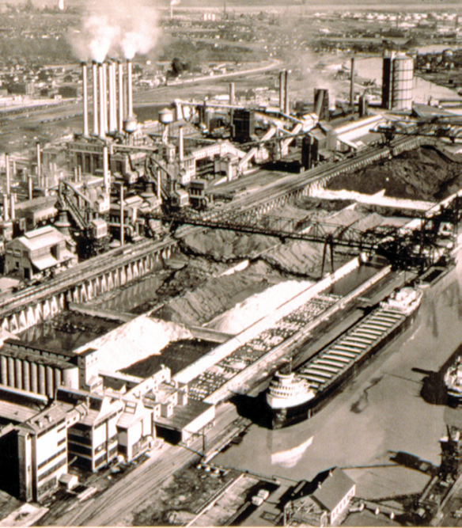
Diseconomies of scale at Ford Motor Company
Henry Ford is well known for his successes producing cars on an assembly line, allowing division of labor to help achieve economies of scale.
Hoping to build on this, Ford built an enormous industrial complex along the River Rouge in Dearborn, Michigan, to produce the Model A.
The Model A lost money for Ford, because the River Rouge complex was too large to allow efficient production, producing a disconnect between workers and management.

Slide 41
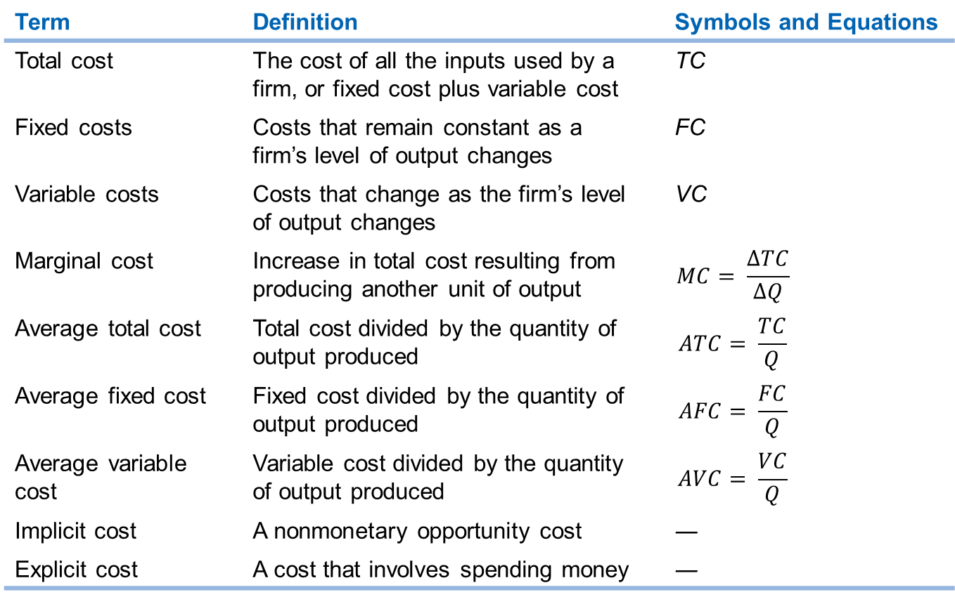
Summary of definitions of cost
Term | Definition | Symbols and Equations
Total cost | The cost of all the inputs used by a firm, or fixed cost plus variable cost | TC
Fixed costs | Costs that remain constant as a firm’s level of output changes | FC
Variable costs | Costs that change as the firm’s level of output changes | VC
Marginal cost | Increase in total cost resulting from producing another unit of output
Average total cost | Total cost divided by the quantity of output produced
Average fixed cost | Fixed cost divided by the quantity of output produced
Average variable cost | Variable cost divided by the quantity of output produced
Implicit cost | A nonmonetary opportunity cost | ―
Explicit cost | A cost that involves spending money | ―
Table 11.4
A summary of definitions of cost

Slide 42
Common misconceptions to avoid
A technology in economics refers to the process of turning inputs into outputs.
“Increasing average cost” can occur in the short-run (diminishing returns) or in the long-run (diseconomies of scale). The reasons for the two are not the same.
When calculating marginal product of labor and marginal cost, don’t forget about the denominator (bottom line) in the equation; this is the most common error in calculating these.
The “long run” refers not to a specific period of time, but a conceptual period of time that is sufficiently long to allow all inputs to be altered.

Slide 43
Appendix: Using Isoquants and Isocost Lines to Understand Production and Cost
Use isoquants and isocost lines to understand production and cost.

Slide 44
What determines cost?
Suppose a firm has determined it wants to produce a particular level of output. What determines the cost of that output?
Technology
In what ways can inputs be combined to produce output?
Input prices
What is the cost of each input compared with the other? That is, what is the relative price of each input?

Slide 45
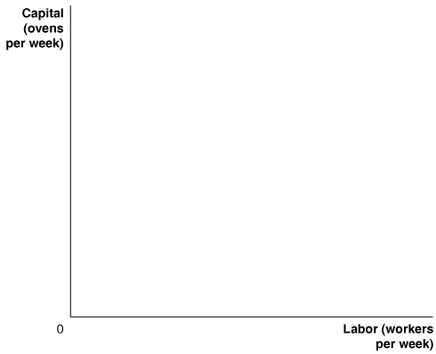
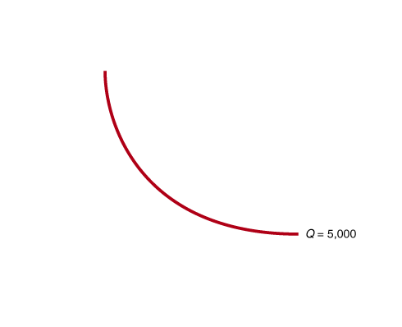
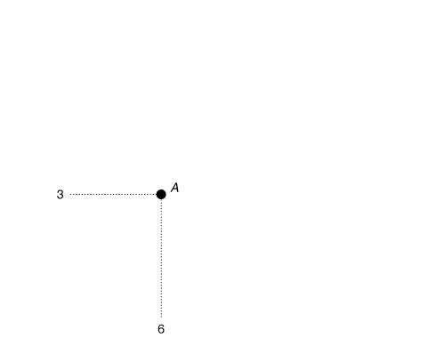
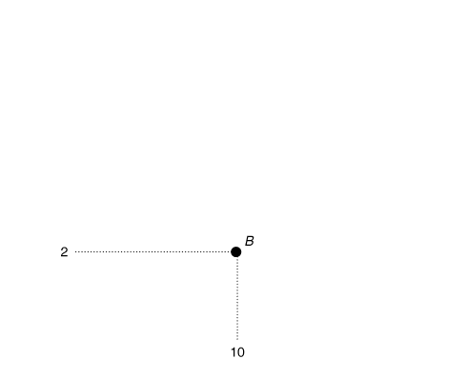
Technology and isoquants
If a firm’s technology allows one input to be substituted for the other in order to maintain the same level of production, then there are various combinations of inputs that will produce the same level of output.
The pizza restaurant might be able to produce 5000 pizzas with either
6 workers and 3 ovens; or
10 workers and 2 ovens.
Figure 11A.1
Isoquants
An isoquant is a curve showing all combinations of two inputs, such as capital and labor, that will produce the same level of output.
Notes:
Isoquants show all the combinations of two
inputs, in this case capital and labor, that will
produce the same level of output. For example,
the isoquant labeled Q = 5,000 shows
all the combinations of ovens and workers
that enable Jill to produce that quantity of
pizzas per week. At point A, she produces
5,000 pizzas using 3 ovens and 6 workers,
and at point B, she produces the same output
using 2 ovens and 10 workers. With more
ovens and workers, she can move to a higher
isoquant. For example, with 4 ovens and 12
workers, she can produce at point C on the
isoquant Q = 10,000. With even more ovens
and workers, she could move to the isoquant
Q = 13,000.

Slide 46
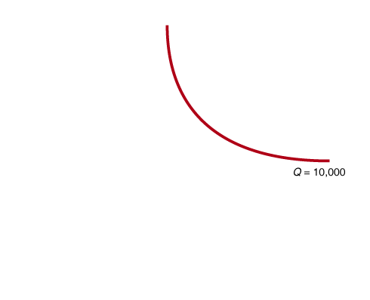
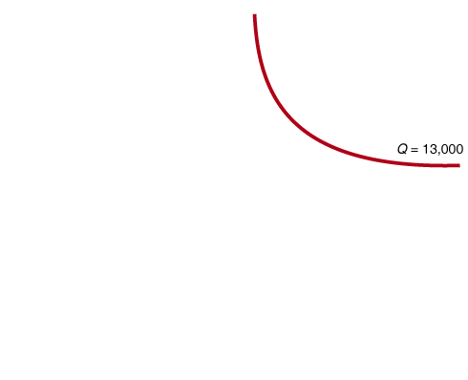
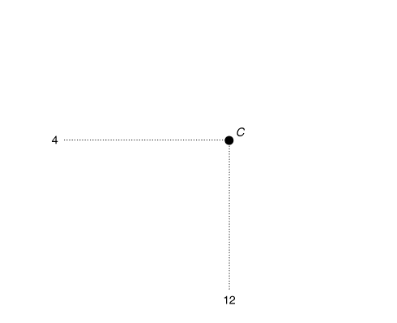
Technology and isoquants—continued
More inputs would allow a higher level of production; with 12 workers and 4 ovens, the restaurant could produce 10,000 pizzas.
A new isoquant describes all combinations of inputs that could produce 10,000 pizzas.
Greater production would require more inputs.
Figure 11A.1
Isoquants

Slide 47
Marginal rate of technical substitution
The slope of an isoquant describes how many units of capital are required to compensate for a unit of labor, while keeping production constant.
This is known as the marginal rate of technical substitution.
For example, between A and B, 1 oven can compensate for 4 workers; the MRTS=1/4.
Figure 11A.1
Isoquants
Additional workers are poorer and poorer substitutes for capital, due to diminishing returns; this results in the MRTS getting smaller as we move along the isoquant, resulting in a convex shape.

Slide 48
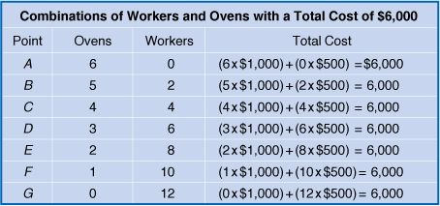
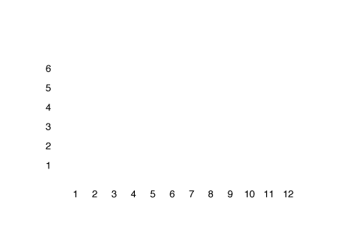
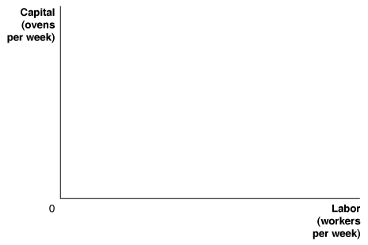






Isocost lines
For a given cost, various combinations of inputs can be purchased.
The table shows combinations of ovens and workers that could be produced with $6000, if ovens cost $1000 and workers cost $500.
The graphical version of this table is known as an isocost line: all the combinations of two inputs, such as capital and labor, the have the same total cost.
Figure 11A.2
An isocost line
Notes:
The isocost line shows the combinations of
inputs with a total cost of $6,000. The rental
price of ovens is $1,000 per week, so if Jill
spends the whole $6,000 on ovens, she can
rent 6 ovens (point A). The wage rate is $500
per week, so if Jill spends the whole $6,000 on
workers, she can hire 12 workers (point G).
As she moves down the isocost line, she gives
up renting 1 oven for every 2 workers she
hires. Any combination of inputs along the
line or inside the line can be purchased with
$6,000. Any combination that lies outside
the line cannot be purchased with $6,000.

Slide 49





The slope and position of isocost lines
With more money, more inputs can be purchased.
The slope of the isocost line remains constant, because it is always equal to the price of the input on the horizontal axis divided by the price of the input on the vertical axis, divided by -1.
The slope indicates the rate at which prices allow one input to be traded for the other: here, 1 oven costs the same as 2 workers: slope = -1/2.
Figure 11A.3
The position of the isocost line
$$Slope=−\frac{P_{Worker}}{P_{Oven}}=−\frac{\$500}{\$1000}=−0.5$$
Notes:
The position of the isocost line depends on
the level of total cost. As total cost increases
from $3,000 to $6,000 to $9,000 per week,
the isocost line shifts outward. For each isocost
line shown, the rental price of ovens is
$1,000 per week, and the wage rate is $500
per week.

Slide 50







Minimum cost combination of capital and labor
Suppose the restaurant wants to produce 5000 pizzas.
Point B costs only $3000, but doesn’t produce 5000 pizzas.
Points A, C, and D all produce 5000 pizzas.
Point A is the cheapest way to produce 5000 pizzas; the isocost line going through it is the lowest.
Observe that at this point, the slope of the isoquant and isocost line are equal.
Figure 11A.4
Choosing capital and labor to minimize total cost
$$At the cost−minimizing combination, \\ \frac{P_{Worker}}{P_{Oven}}=MRTS$$
Notes:
Jill wants to produce 5,000 pizzas per week
at the lowest total cost. Point B is the lowestcost
combination of inputs shown in the
graph, but this combination of 1 oven and
4 workers will produce fewer than the 5,000
pizzas needed. Points C and D are combinations
of ovens and workers that will produce
5,000 pizzas, but their total cost is $9,000.
The combination of 3 ovens and 6 workers
at point A produces 5,000 pizzas at the lowest
total cost of $6,000.

Slide 51









Different input price ratios lead to different input choices
If prices change, so does the cost-minimizing combination of capital and labor.
Suppose we open a pizza franchise in China, where ovens are more expensive ($1500) and workers are cheaper ($300). The isocost lines are now flatter.
To obtain the same level of production, we would substitute toward the input that is now relatively cheaper: workers.
Figure 11A.5
Changing input prices affects the cost-minimizing input choice
Notes:
As the graph shows, the input combination
at point A, which was optimal for Jill, is not
optimal for a businessperson in China. Using
the input combination at point A would
cost businesspeople in China more than
$6,000. Instead, the Chinese isocost line is
tangent to the isoquant at point B, where the
input combination is 2 ovens and 10 workers.
Because ovens cost more in China but
workers cost less, a Chinese firm will use
fewer ovens and more workers than a U.S.
firm, even if it has the same technology as
the U.S. firm.

Slide 52








The changing input mix at Disney film animation
Disney can use various combinations of computers and animators to produce an animated film.
When computing power was relatively expensive in the early 1990s, Disney used more animators and less computing power.
Decreases in the price of computing power have changed the relative price of its inputs, prompting Disney to change its optimal mix of inputs.

Slide 53

Another look at cost minimization
We observed that at the minimum cost level of production, the slopes of the isocost line and the isoquant were equal.
Generally, writing labor as L and capital as K, we have:
$$Slope of isoquant=−MRTS=−\frac{P_{L}}{P_{K}}=Slope of isocost line$$
Hence at the cost-minimizing level of production, MRTS = P_{L}/P_{K}.
The MRTS tells us the rate at which a firm is able to substitute labor for capital, given existing technology.
The slope of the isocost line tells us the rate at which a firm is able to substitute labor for capital, given current input prices.
These are equal at the cost-minimizing level of production, but there is no reason they should be equal elsewhere.

Slide 54


Interpreting the marginal rate of technical substitution
Suppose we move between two points on an isoquant, increasing labor and decreasing the capital used.
When we increase labor, we increase production by the number of workers we add, times their marginal production:
Change in quantity of workers x MP_{L}
We can interpret the reduction in output from reducing capital in the same way: it is equal to the amount of capital we remove, times the marginal production of that capital:
– Change in quantity of workers x MP_{K}
Since we are moving along an isoquant, these are equal:
−Change in the quantity of ovens × MP_{K} = Change in the quantity of workers × MP_{L}

Slide 55
Interpreting the MRTS—continued
Rearranging this equation gives:
The left-hand side is the slope of the isoquant: the MRTS. Therefore we have:
Since the slopes of the isocost line and isoquant are equal at optimality, we have:
using the common terminology that the price of labor is the wage (w) and the price of capital is its rental price (r).

Slide 56
Interpreting the MRTS—continued again
We can rearrange this last equation to give:
Interpretation: at the cost-minimizing input combination, the marginal output of the last dollar spent on labor should be equal to the marginal output of the last dollar spent on capital.
We could use this idea to determine whether a firm was producing efficiently or not: if an extra dollar spent on capital produced more (less) output than an extra dollar spent on labor, then the firm is not minimizing costs; it could:
increase (decrease) capital, and
decrease (increase) labor,
maintaining the same level of output and lowering cost.

Slide 57

Do NFL teams behave efficiently?
NFL teams face a salary cap, and try to maximize wins subject to this total cost.
Teams face an important choice between trying to win with veterans or rookies. If the teams are optimizing, the marginal productivity per dollar spent on each type of player should be equal.
Economists Cade Massey and Richard Thaler found that teams were over-spending on high draft picks; they attributed this to NFL general managers being overconfident in their ability to spot NFL-level talent among college players.

Slide 58








Expanding production in the short run
A bookcase manufacturing firm produces 75 bookcases a day, using 60 workers and 15 machines.
In the short run, if the firm wants to expand production to 100 bookcases, it must do so by employing more workers only; the number of machines is fixed.
0
Figure 11A.6
The expansion path
Notice that there is are lower-cost combination of inputs (like point C) that would produce 100 bookcases; in the long run, the firm will switch to one of those.
Notes:
The tangency points A, B, and C lie along
the firm’s expansion path, which is a curve
that shows the cost-minimizing combination
of inputs for every level of output. In the
short run, when the quantity of machines
is fixed, the firm can expand output from
75 bookcases per day to 100 bookcases per
day at the lowest cost only by moving from
point B to point D and increasing the number
of workers from 60 to 110. In the long
run, when it can increase the quantity of
machines it uses, the firm can move from
point D to point C, thereby reducing its total
costs of producing 100 bookcases per day
from $4,250 to $4,000.

Slide 59





Expanding production in the long run
Point C is a combination on the long-run expansion path for the firm: a curve that shows the firm’s cost-minimizing combination of inputs for every level of output.
We can tell because the isocost line and isoquant are tangent at point C.
0
Figure 11A.6
The expansion path
Point A minimizes costs for a lower quantity (50).
The expansion path is the set of all cost-minimizing bundle, given a particular set of input prices.

